Slide 1

UNIVERSITY PLACEMENT DATA ANALYTICS

Slide 2









STUDENT ACADEMIC PROFILING
COMPANY PROFILES
STUDENT PLACEMENT
STUDENT SOCIAL PROFILING
COLLEGE PLACEMENT
PLACEMENT RATE
Aims to develop an integrated data analytics framework to optimize university placement operations and enhance student experiences through data-driven insights, striving to improve student placement rates.
Enhancing student placement outcomes, providing effective career guidance, and empowering college growth through targeted strategies, and curriculum optimization to address challenges and improve placement rates effectively.
PROBLEM DEFINITION
OBJECTIVE
KEY
PERFORMANCE
INDICATORS

Slide 3
EXECUTIVE SUMMARY
Explore placement outcomes based on MBA specialization (HR, Finance, Marketing ).
Identifying which specialization has the maximum number of placements.
Analyze the relationship between ICET rank and student placements.
Investigate gender disparities in placement outcomes.
Determine the number of offers received by students and their distribution across various attributes.
Analyze placement patterns pertaining to companies.

Slide 4
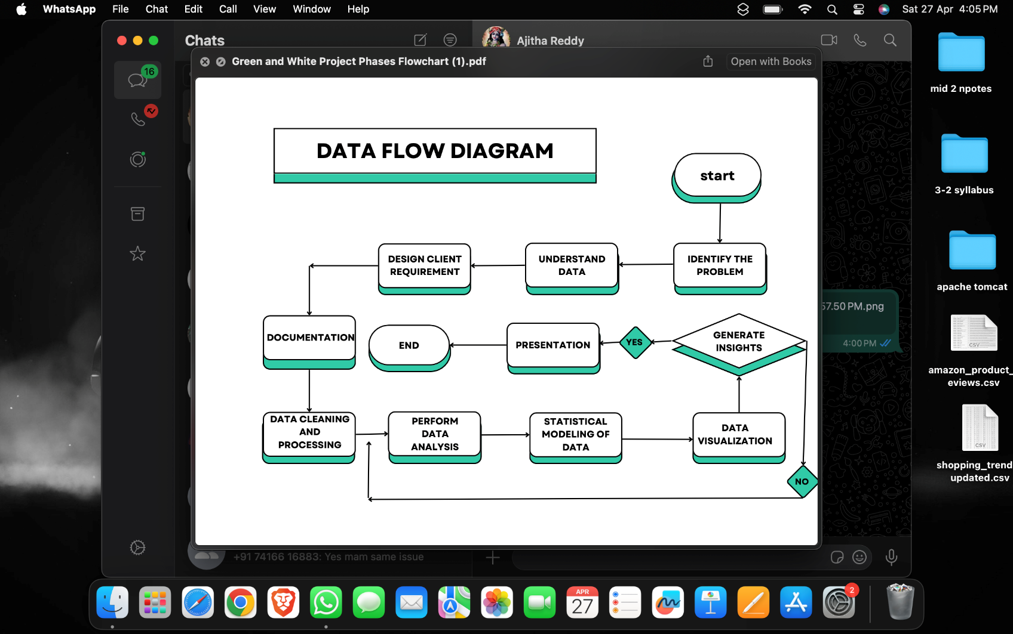

Slide 5

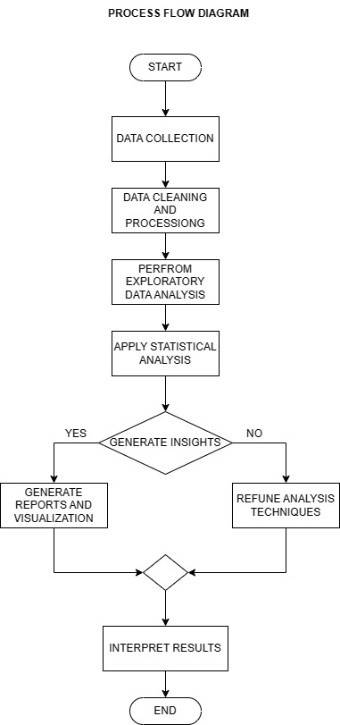







LIST OF ENTITIES
PROCESS FLOW DIAGRAM
University
Recruiters/Companies
Placement-training cell
Students
Student Education
MBA
Student placement
No of placements

Slide 6
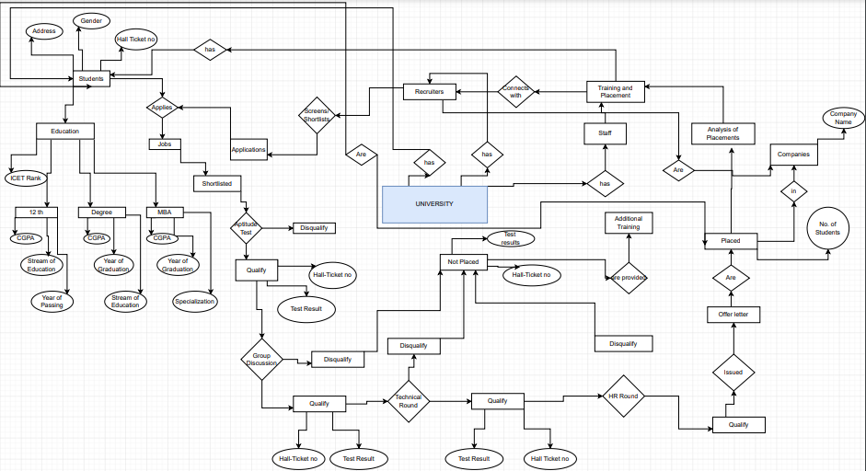

Slide 7
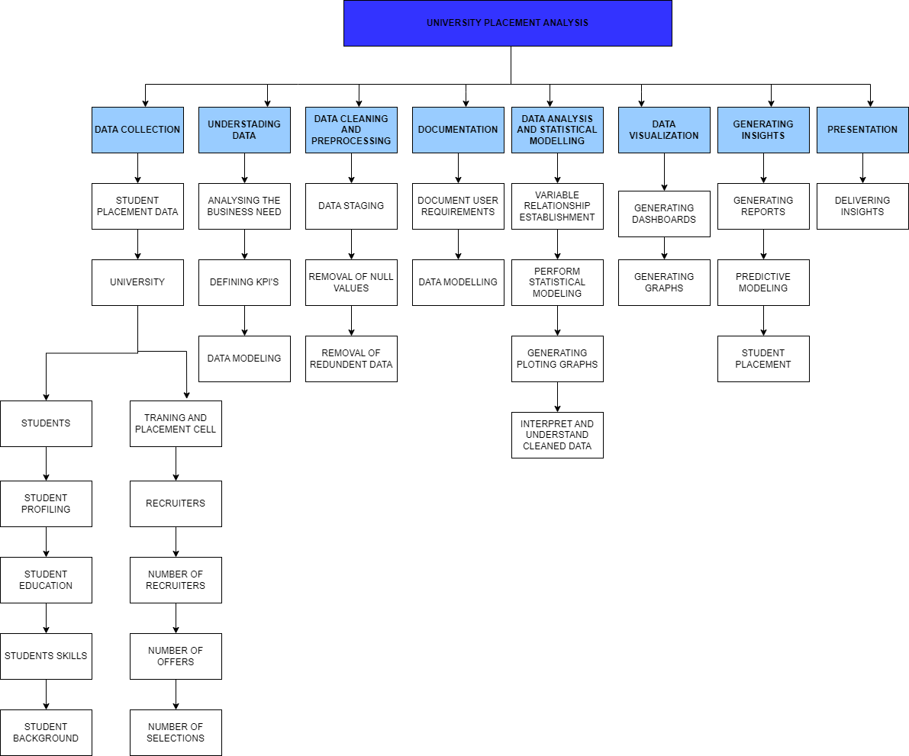
UNIVERSITY PLACEMENT ANALYSIS

Slide 8
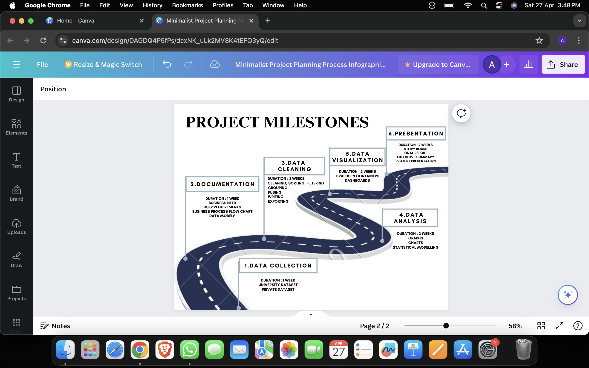

Slide 9
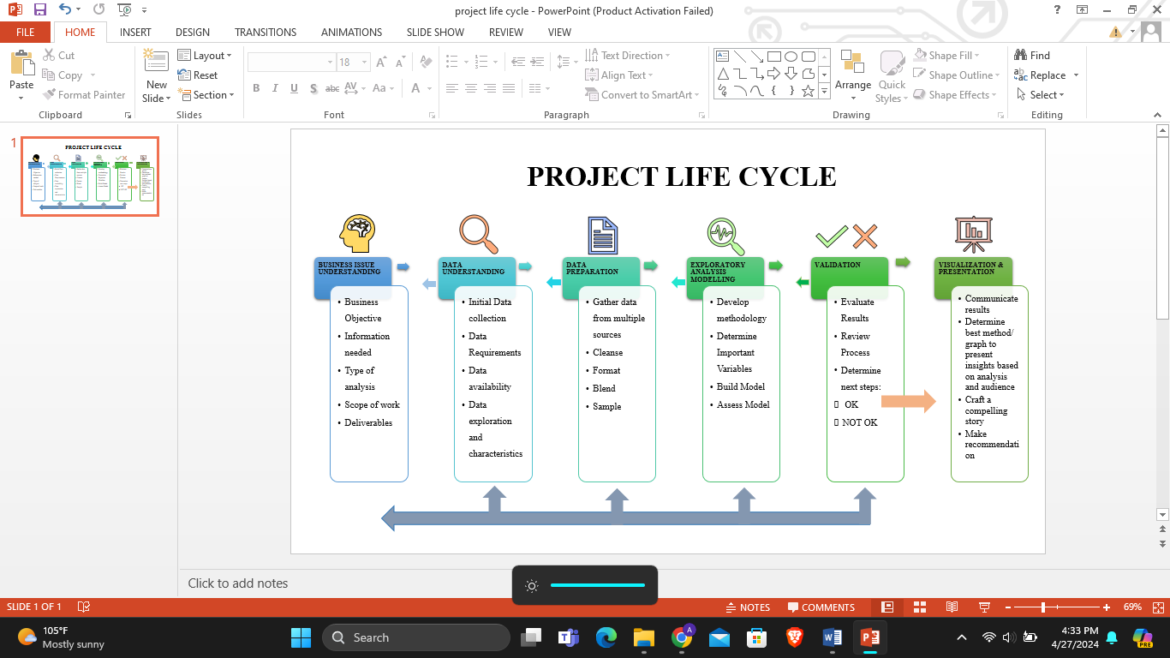

Slide 10

DATA MODELLING
ENTITY-RELATIONSHIP DIAGRAM
PROCESS FLOW DIAGRAM
ACTIVITY DIAGRAM
USE CASE DIAGRAM
STATE CHART DIAGRAM

Slide 11










Data cleaning:
Excel, Python
Data modelling:
Star UML, Draw.io
Data analysis and visualization:
Python : Jupyter notebook,
Libraries: Numpy, matplotlib, sklearn,
Dashboards:
Power BI, Tableau
Documentation: Word
Presentation: Microsoft Power Point

Slide 12
THANK YOU
TEAM : 3
23MG202A05 – CHANDRA PAUL
23MG202A13 – ANVITHA
23MG202A19 – AJITHA
23MG202A23 - SAMI
23MG202A24 – VISHAL
23MG202A28 - VISHNU

